Slide 1
Feature 10508: Break point generator
Utkarsh Shigihalli & Jakob Ehn

Slide 2
FEATURE 10508: BREAK POINT GENERATOR
What:
Ability to set breakpoints on multiple methods at the same time and navigate to history.
Deliverable: VS extension.
Why:
This gap was raised since VS 2010 and other interactions with customers.
TracePoints exists in the product at the moment.
Would like to navigate to history points about custom events, static analysis of all the public entry points that occurred, and then present in a UI with checkboxes or a wizard, and then place trace points.
It would help customers to think ahead of what they really want.

Slide 3
Context

Slide 4
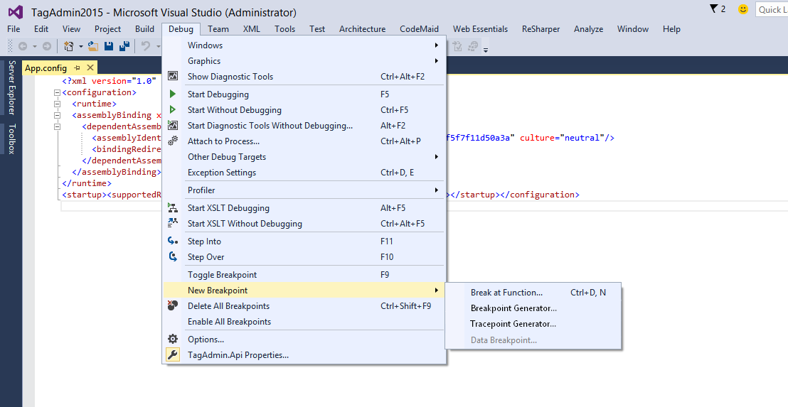
Scenario
New menu item in the main Debug menu. Call it Breakpoint/Tracepoint generator

Slide 5
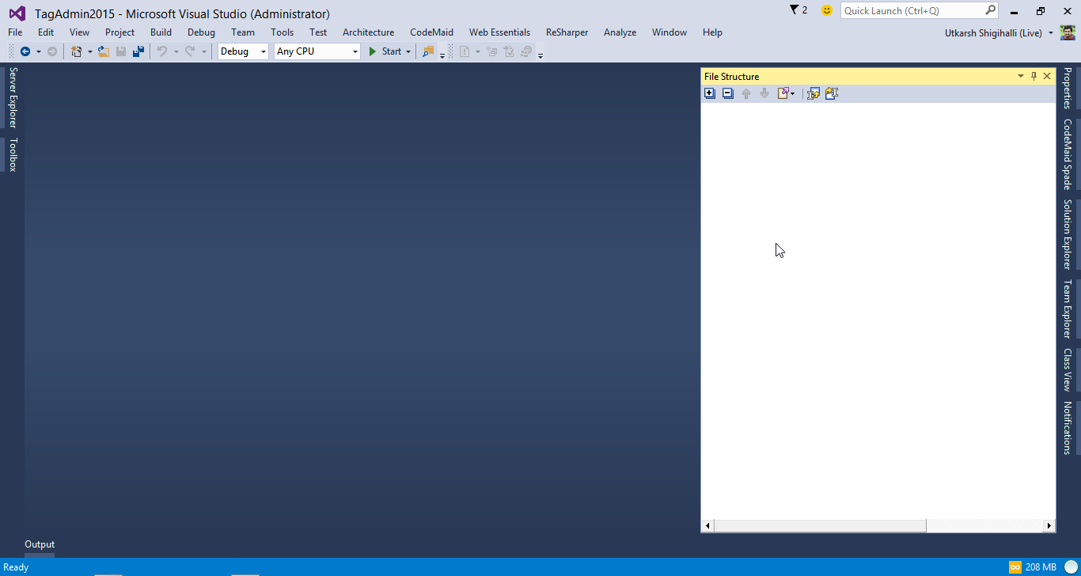
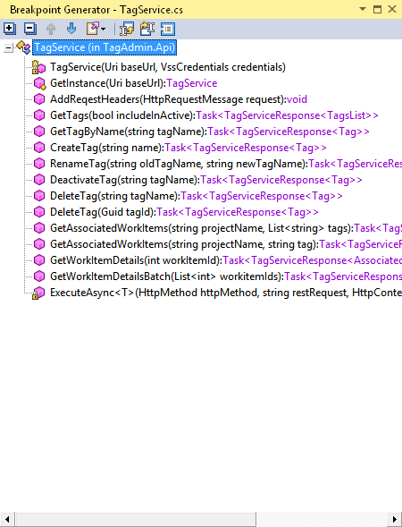

Scenario
If user has chosen single file, we show public entry points only for that file, similarly for project show all entry points available in project
Should we allow user to do this solution wide or only per project basis (to avoid creating huge trace points accidently) ??
Generate

Slide 6
Scenario
Should we have a button here to click a generate the tracepoints? Or can we avoid clicking a button?
Generate

Slide 7
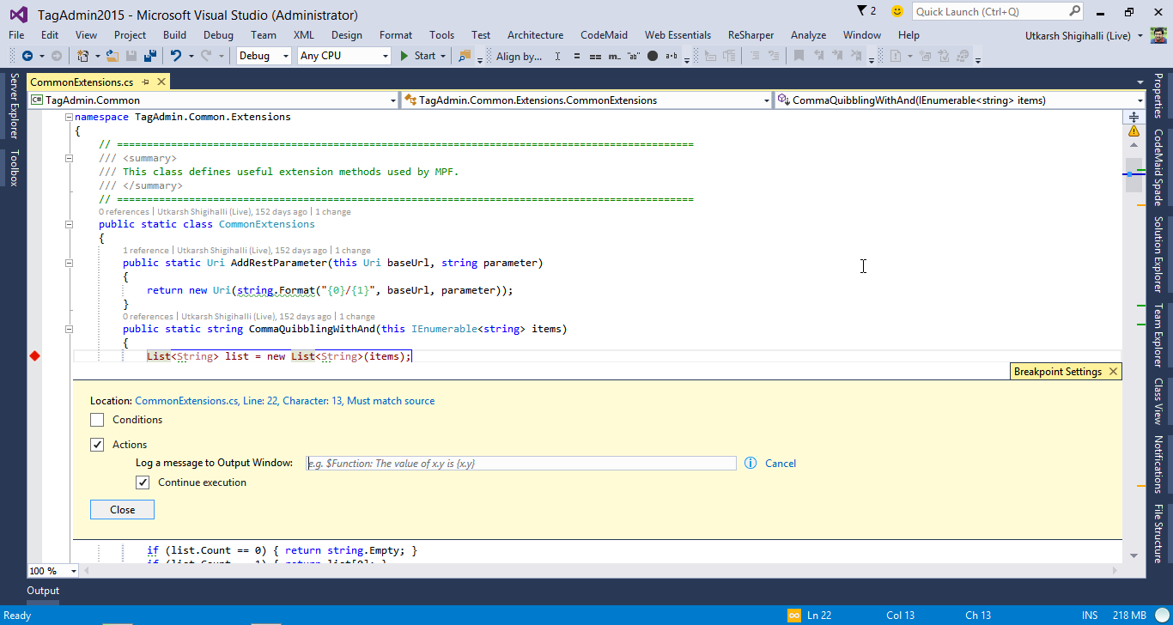
Clicking Generate will add a trace point to 1st line of the public entry points with a default expression – That expression needs to be finalized

